Slide 1
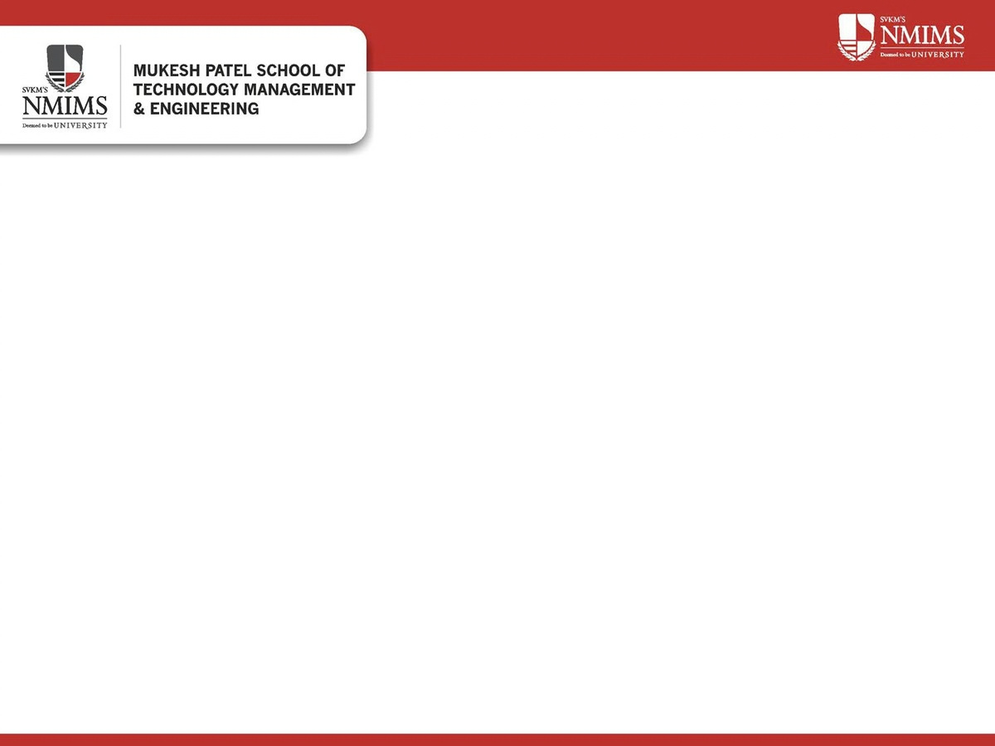


B.Tech (CE)
Semester: III
Course: Data Structure and Algorithms
Academic Year: 2026-27
Presented by: Ishansh Thada - 70022500334
Rajat Agrawal - 70022500345
1

Slide 2
Index
    Introduction
    Problem Statement
    Objectives
    Data Structures Used
    Linked List & Tree
    Navigation Stack & Recent Files Queue
    Time Complexity Analysis
    Flow of the Code
    Output
    Conclusion & Future Scope
2

Slide 3
Introduction
What is the CLI File Explorer?
  A terminal-based simulation of an operating system's directory and file manager.
  Implemented entirely in C using dynamic pointers and memory allocation without external database libraries.
Core Components:
  General Tree: Models folders containing subfolders and files.
  LIFO Stack: Keeps track of visited parent folders for fast step-back navigation.
  FIFO Queue: Logs accessed files in chronological order.
3

Slide 4
Problem Statement
1. Difficulty in Organizing Folders: Fixed-size arrays cannot easily represent nested folders with different levels of depth.
2. Difficulty in Folder Navigation: Moving between folders requires keeping track of the previous directory to support the Go Back operation.
3. Lack of File Access History: There is no simple way to track recently opened files in the order they were accessed.
2

Slide 5
Objectives
Main objectives are:
    To implement an interactive in-memory file manager in C using DSA.
    To model multi-level hierarchical folders using a Left-Child / Right-Sibling Tree.
    To implement an array-based Stack for parent directory backtracking.
    To implement a linked-list Queue for chronological recent-file logging.
    To demonstrate real-time interaction between multiple data structures in one system.
    To provide search using recursive Depth-First Search (DFS) traversal.
    To create an intuitive, menu-driven CLI interface.

Slide 6
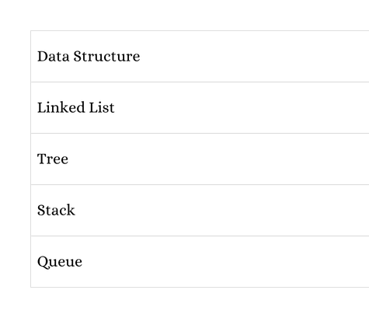
Data Structures Used
    Linked List: Allows dynamic insertion and deletion of files and folders.
    Tree: Represents parent-child relationships between directories and their contents.
    Stack: Follows LIFO (Last In, First Out), allowing users to return to the previous folder.
    Queue: Follows FIFO (First In, First Out), maintaining files in the order they were accessed.

Slide 7
Data Structures Used — Linked List & Tree
Linked List (File and Folder Management):
    Stores multiple files and folders inside a directory.
    Each node contains the name and type of the file or folder.
    Uses pointers to connect different nodes.
    Allows dynamic memory allocation.
Tree Structure (Directory Hierarchy):
    Represents the relationship between folders and their contents.
    Each folder can contain multiple files and subfolders.
    child points to the first item inside a folder.
    next points to the next item in the same directory.

Slide 8
Stack, Queue & Core Operations
Stack (Folder Navigation):
    Used to maintain the history of previously visited directories.
    Push operation stores the current folder before opening another folder.
    Pop operation retrieves the previous folder when Go Back is selected.
Queue (Recently Accessed Files):
    Maintains a record of opened files.
    Uses front and rear pointers.
Key Operations Summary:
    addNode() – Creates and inserts a new file or folder.
    display() – Displays the contents of the current directory.
    deleteNode() – Removes a file or folder.
    search() – Searches for a file or folder recursively.
    addRecent() – Adds an accessed file to the queue.
    showRecent() – Displays recently accessed files.

Slide 9
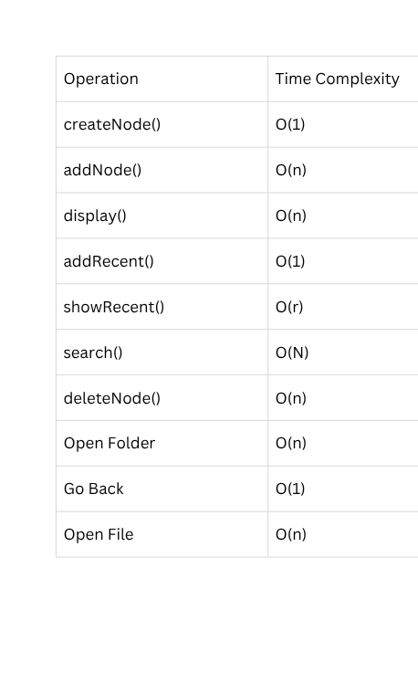
Time Complexity

Slide 10
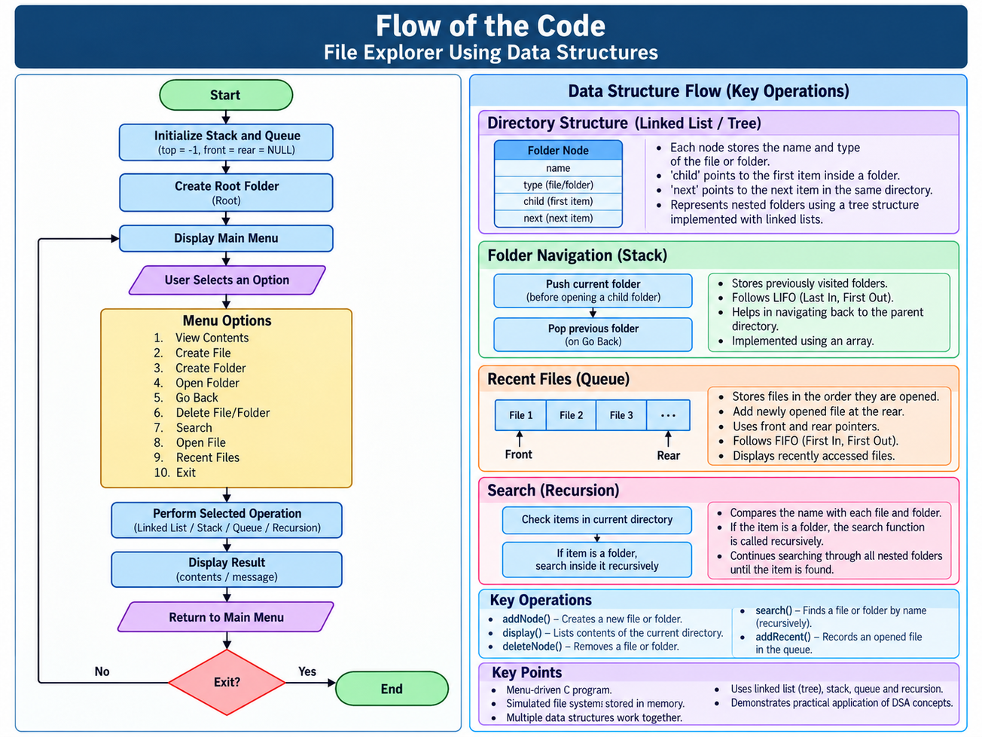

Slide 11
Data Structure Flow:
    File System → Linked List / Tree
    ↓
    Create File/Folder → Insert New Node
    ↓
    Open Folder → Push Current Folder into Stack
    ↓
    Go Back → Pop Previous Folder from Stack
    ↓
    Open File → Add File to Queue
    ↓
    Search → Recursively Traverse Nested Folders
    ↓
    Display / Delete → Traverse and Update Linked List

Slide 12
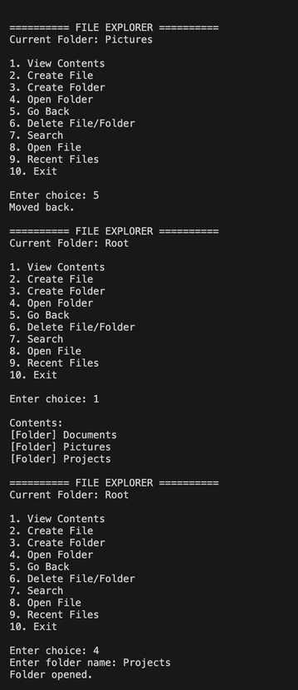
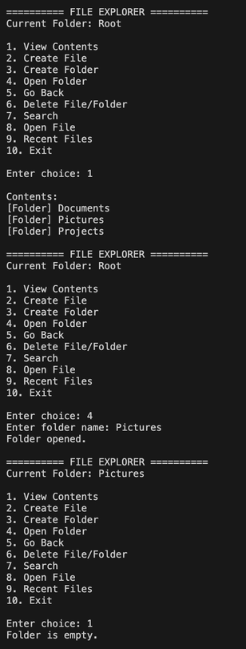
Output

Slide 13
Conclusion & Future Scope
Conclusion
    The project demonstrates the practical implementation of Linked List, Tree, Stack, and Queue.
    These data structures work together to manage files, folders, and navigation history.
    Recursive searching allows files to be located across nested directories.
Future Scope
    Add support for file renaming.
    Add recursive deletion of folders and their contents.
    Implement file sorting based on name or type.
    Develop a graphical user interface.
    Integrate actual system file management operations.

Slide 14
Thank you

